Slide 1
Career Development Seminar: Interviewing – Preparing to Succeed
Instructor: Margaret Roberts
Director, Eberhardt Career Management Center

Slide 2
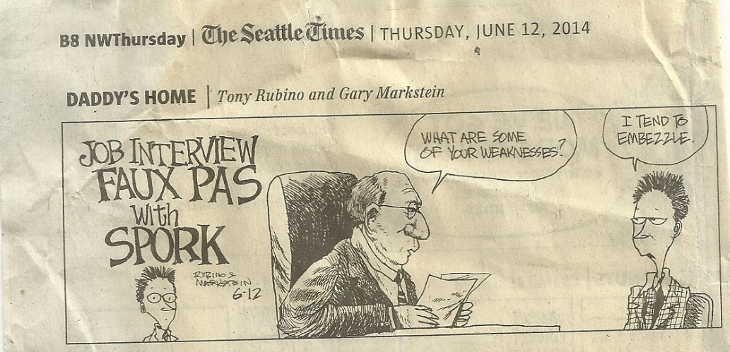
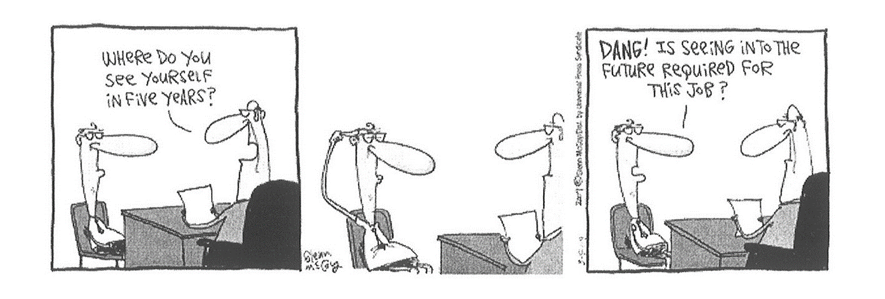
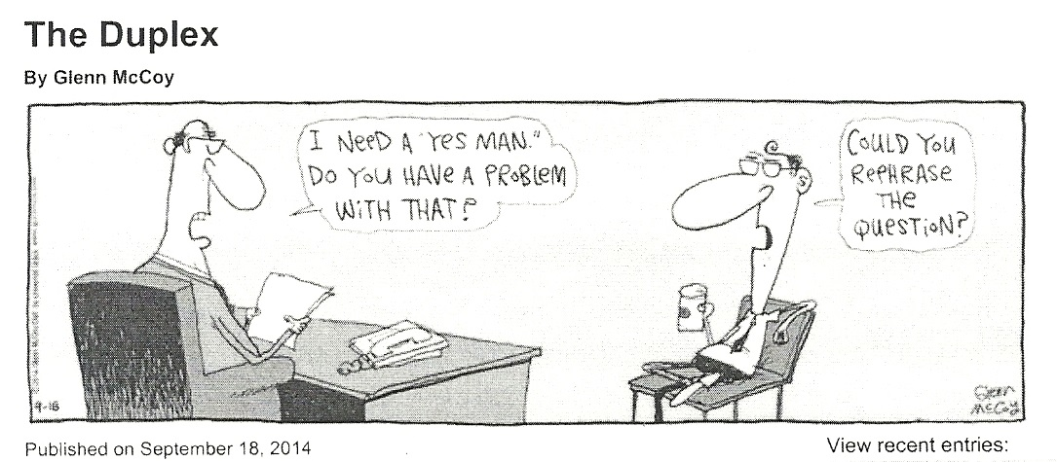

Slide 3
Survey says… From a SHRM survey of nearly 500 HR managers:
30% of hiring managers will decide whether to hire you within 15 minutes
70% prefer job candidates to have unpaid internship experience directly related to their companies' work versus paid employment in an unrelated field
39% say "chemistry" with a job applicant accounts for half of their hiring decision
Source: WSJ article Nov 14, 2009 “Avoid these Interview Killers”

Slide 4
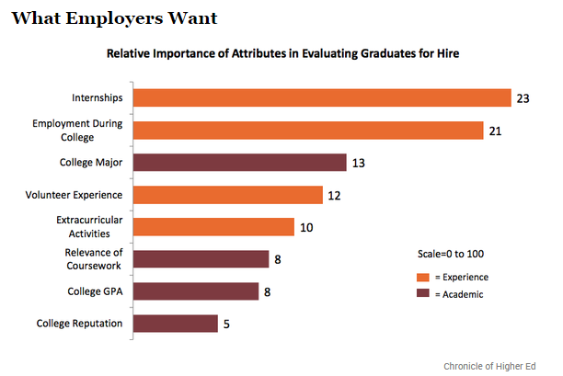
What employers want in college grads
Source: TheAtlantic.com: The Thing Employers Look for When Hiring College Graduates, Aug 19, 2014.

Slide 5
Interview Formats
Phone / Skype / Other Virtual platforms
Low cost, minimal restrictions
Often used for initial screening
In Person
On-Campus Interviews
Company Site
Multiple rounds, several people involved at various levels

Slide 6
Interview Structure
Traditional 1:1 – conversation with a recruiter, hiring manager, member of the team you’ll join
Panel (2+) – efficient method for companies to engage several people in meeting candidates
Case – Specific question, situation, problem or challenge presented to the candidate. The case is often a business situation or a business case the company has faced. These are used to “test” your critical thinking, problem solving and analytical skills. Sometimes they are presented to teams of candidates to evaluate how you work with others.

Slide 7


Interview Prep Checklist:
Industry & Company research
Hiring team research (always ask who you will be meeting!)
Common interview question review / practice
Outline your best stories / practice
Type up your questions for the employer (don’t rely on memory!)
Map out your route and do a test run if possible!
Repeat # 3 & #4 until you are confident!

Slide 8
Industry & Company Research
What are you looking for?
Company/Industry basics
Trends that may affect hiring needs
New products (theirs or competitors)
Changes in economy that can affect company success
Information that will help you sell yourself as the best candidate
Online Resources
Company Website
Company’s social media properties
Business press – WSJ, Bloomberg BusinessWeek, etc.
Glassdoor.com – tips on the interview process, compensation, etc.

Slide 9
Fact finding / background questions
Typically employed to confirm information or delve deeper into your background.
E.g. minimum qualifications,
personal career goals (short-term and long-term) / motivations,
“test” your knowledge of the company/industry.
Is there anything on your resume that doesn’t jive with your answers?

Slide 10
10 most common interview questions Source: US News, April 2015
Tell me about yourself.
What interests you about this job / company / industry?
Why did you leave your last job? (or why are you leaving?)
Why would you excel at this job?
What do you know about our company so far?
Tell me about a time when.. (fill in key skill they look for in candidates)
What would you do in your first 90 days on the job?
What is most important to you in a new position?
What salary range are you looking for?
What questions do you have for me?

Slide 11
Behavioral Interview Questions
Based on the premise that past performance is a predictor of future performance.
Responses need to be specific and detailed. Frame response as a STAR or PAR statement;
1. Situation/Task (or Problem)
2. Action you took or contribution made
3. Result you achieved; tell a story!
Interviewer wants real examples of your prior experiences not hypotheticals

Slide 12
Typical Behavioral Questions Source: http://biginterview.com/blog/behavioral-interview-questions
Tell me about a time you stepped up into a leadership role.
Tell me about a time when you worked with a difficult team member.
Tell me about a situation where you had to solve a difficult problem.
Tell me about a time when you had to analyze information and make a recommendation.
Describe a situation in which you found a creative way to overcome an obstacle.
Tell me about a time that you took the lead on a difficult project.
What’s your greatest professional failure?
Tell me about a decision that you regret.

Slide 13
5-Step Storytelling Method
WHY you chose (school, job, volunteer exp, etc)
WHAT you accomplished
WHAT you brought uniquely to the table
WHAT you learned
WHY you left (show intentionality) – may not be applicable in every scenario
This works particularly well on questions like:
Why did you choose UOP?
Why did you leave this job?
Why did you change your major?
What motivated you to volunteer with XYZ?

Slide 14
Tell me about yourself….
I was born in Aromas, CA…
I’m a junior at University of the Pacific…
I’m a marketing major
Why are these not good opening statements?
Use this question to ‘sell your brand’ and tie your qualifications to the opportunity
Your answer does not have to be a big speech, but should make you stand out from other candidates – don’t miss out on a chance to shine

Slide 15
I vs. We – group/team stories
An employer is generally not looking to hire a team of people;
Tell YOUR story, not the collective “we” story;
Distinguish between what you had individual ownership / accountability for and what was a team contribution to success
If you can’t articulate your individual contribution it will be hard for employers to see your leadership potential

Slide 16
When it’s your turn to ask ?’s
Do make questions meaningful and relevant – demonstrate that you researched the firm
Do ask about manager or team members experiences in company and industry
Do ask about expectations of new hires (ie., how can I best prepare to hit the ground running before I start working here, etc.)
Don’t ask questions that are easily answered on the company website
Don’t ask about $ or benefits until you are discussing an offer

Slide 17
Know What Constitutes Illegal Questioning
You are NOT required to answer any questions pertaining to:
Religion, Marital Status, Financial Status, Ethnicity/Origin, Disability/Health, Sexual Orientation, Family, Political Affiliation
Intent to marry or have children
Some states and cities are banning salary history questions
Massachusetts enacted this ban last year, CA & NY considering similar legislation
Philadelphia bill was passed unanimously by city council, mayor signature pending as of last week

Slide 18
What do I wear to an interview? It depends….
Formal / Conservative Environment = BUSINESS SUIT
Well fitting, appropriate length, clean and pressed with dress shoes & belt matching color
Minimal accessorizing
Informal / Less Conservative Environment = Business CASUAL
Slacks, collared shirt or nice blouse, jacket optional, no tie
Accessories may be a little more creative (use good judgement)
Casual / Startup / Tech Environment = Follow their lead
Jeans are often acceptable for interviews in these situations but it can’t hurt to ask the recruiter for guidelines

Slide 19
On-Campus Interviews
Submit resumes, cover letters, transcripts (as required) via Tiger Jobs – don’t miss deadlines
Follow employer instructions for add’l application process (company website)
Watch your account for notification of interview invites and pick your interview slots

Slide 20
Mock Interviews - Feb 6-10
DRESS PROFESSIONALLY
Be on time. Be prepared. Write a thank you note!!!
After you have completed the mock interview, submit your reflection on Canvas
Reflection is due by 11:59pm on Sunday, Feb 12

Slide 21
Correspondence in the Job Search Every instance of engagement with a recruiter, hiring manager or business professional is an opportunity to influence a hiring decision on some level
Cover Letters
Email Communications & any follow up
Thank You notes
LinkedIn outreach
Each of these has a different purpose / goal in advancing our job search efforts. The constant between them is the necessity for:
Professionalism
Business language
Proper grammar / spelling
Your email messages are likely to be forwarded “as is”. Be sure they are appropriate for any audience.
“Hey” is NOT a professional way to address someone in your job search
Timely communication is key! Send thanks w/in 24 hours of an interview

Slide 22
Reminders…
THIS WEEK – Jan 30-Feb 3:
Develop / refine your draft resume
Get feedback at a drop in session (cmc or crc)
Prepare for your mock interview!
Week of Feb 6:
No class – review the online content!!! Complete quiz.
Conduct your mock interview. Complete reflection.

